Slide 1
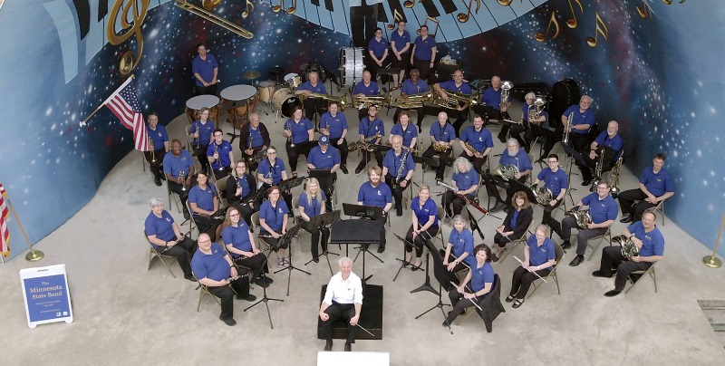
The Minnesota State Band Welcomes You

Slide 2
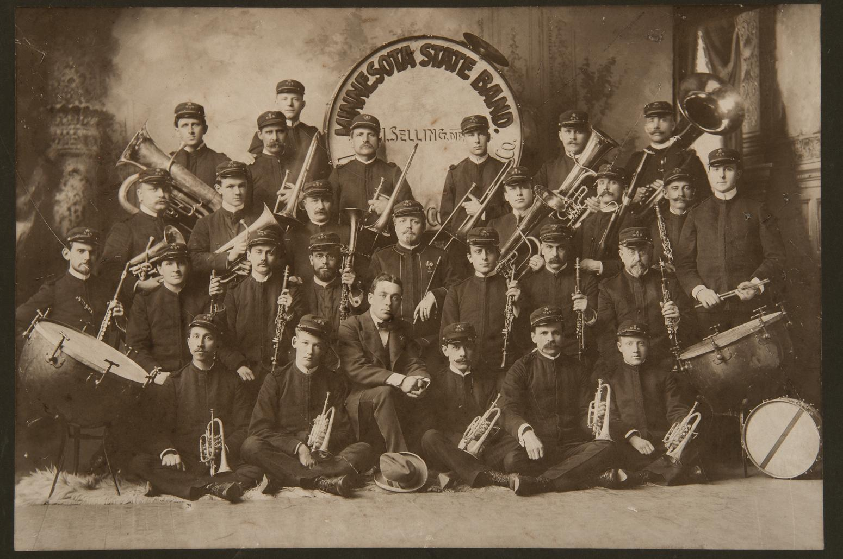
The Minnesota State Band - 1898
Notes:
2

Slide 3
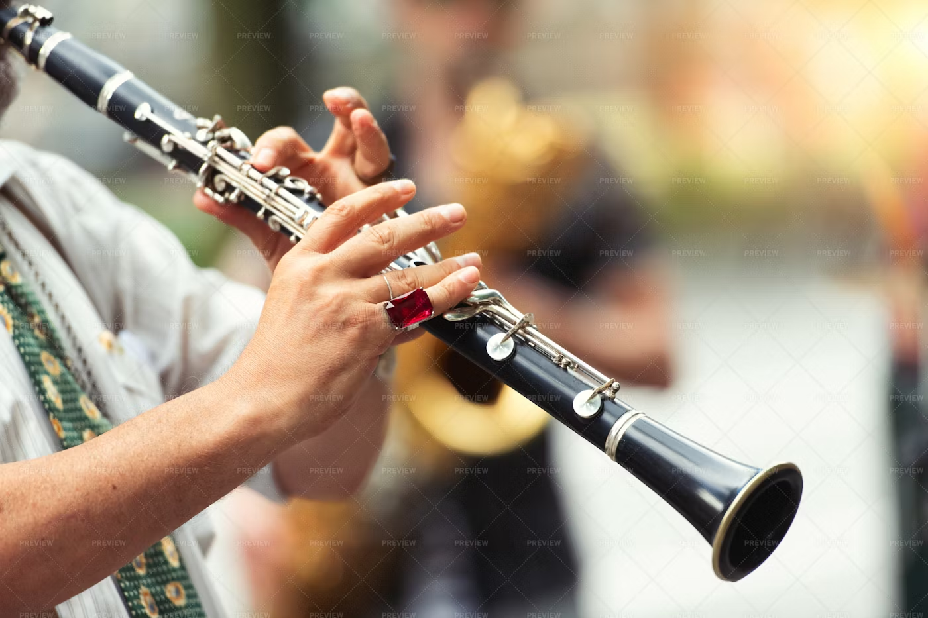
Clarinets
Today we are featuring the Clarinet section of the Band.
Since 1898, there have been 136 Clarinetists who have played with the Band (that we know of). This number includes those who played e-flat and bass clarinet.

Slide 4
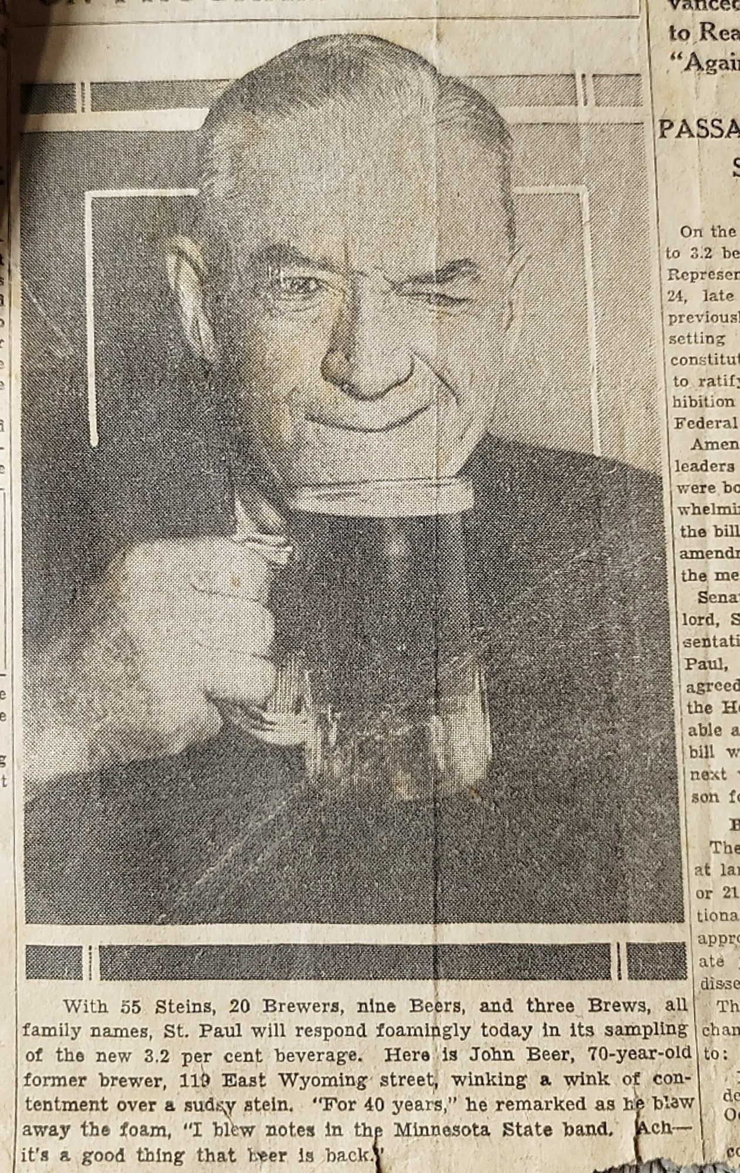
John Beer
Played in the MSB 1898 - 1938
John Beer was born in Austria and came to the U.S. in 1880. He was a charter member of the Minnesota State Band and played with the Band for almost 40 years.
This photo was taken when Prohibition ended. The caption reads in part: Here is John Beer, 70-year-old former brewer, winking a wink of contentment over a sudsy stein. “For 40 years I blew notes in the Minnesota State Band. Ach – it’s a good thing that beer is back.”
Notes:
Slide 5 – Como Park Concert
This picture is from 1904, before the current Como Park pavilion was built. The audience faced toward the lake, and the band entertained them from a barge out on the water. There is nothing to identify the band on the barge in this picture, but since it was taken in 1904, the band is most likely the Minnesota State Band.
Music
Next Slide
4

Slide 5
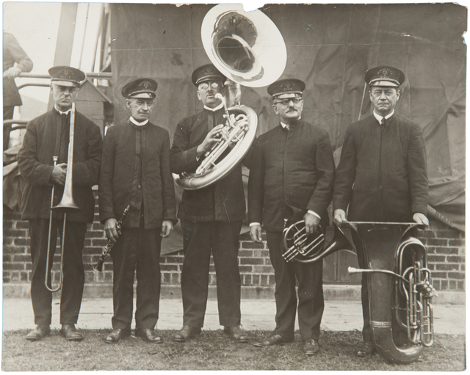
Minnesota State Fair Grandstand – 1911?
John Beer is the clarinetist in this photo – 2nd from the left.
Notes:
Slide 17 – State Fair
Music
Next slide
5

Slide 6
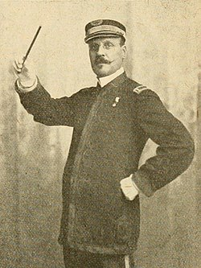
Oscar Ringwall
Mr. Ringwall was a Swedish immigrant. He played in Gilmore’s band in Boston then entered the United States Army as a band leader. When he came to Minnesota, he was a member of several local bands and later organized his own military style bands. He was well-known musician in the Twin Cities for more than 25 years.

Slide 7
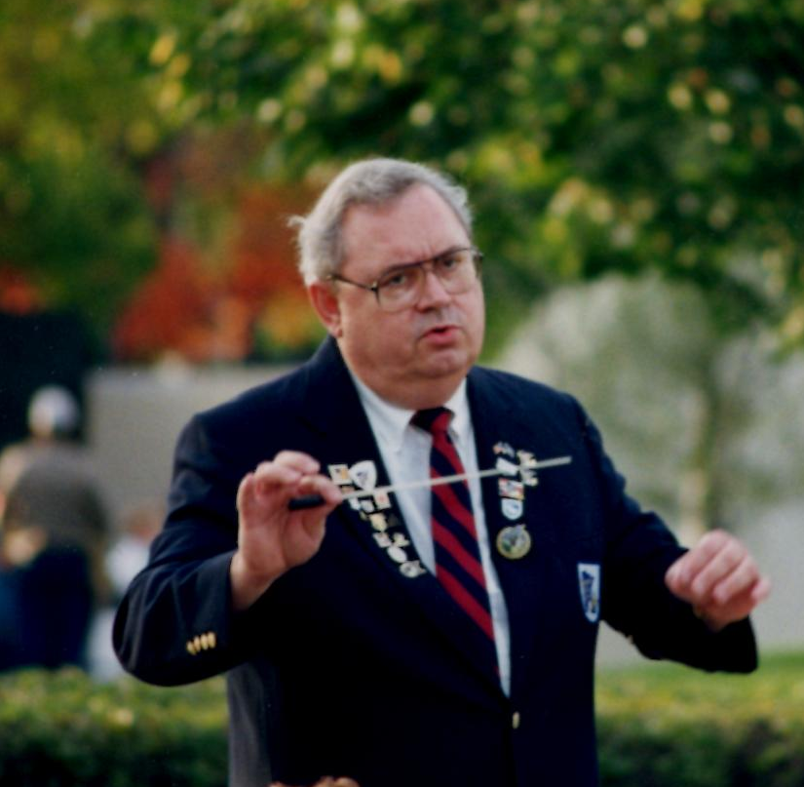
Joseph Komro
Member of the MSB 1963 - 2004
Joe Komro was 19 years old when he started playing clarinet with the MSB in 1963. After 10 years, he took over as Director and became the longest-serving Director of the Band – 30 years.

Slide 8
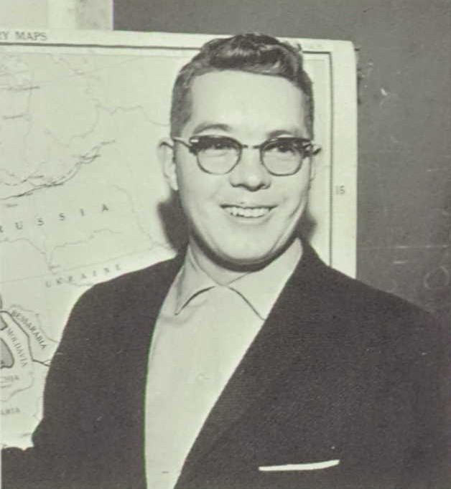
Charles E. Bottemiller
Member of the MSB 1974 - 1999
Charles also played in the 451st Army Band and the Bavarian Musikmeisters, performing in at least 30 concerts a year. He was a graduate of Macalester College and taught history/social studies at Simley High School for 18 years.

Slide 9
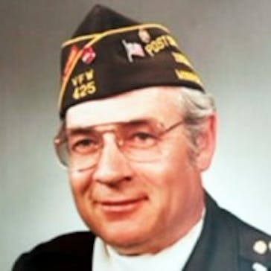
Jack Steinmetz
Member of the MSB 1994 - 1998
Jack played clarinet in the Eden Prairie Community Band, Letter Carriers' Band, as well as the MSB. He volunteered many years at the State Fair demonstrating letterpress printing at the Living History Exhibit. He was a beekeeper, readily giving away jars of honey and his homegrown vegetables.

Slide 10
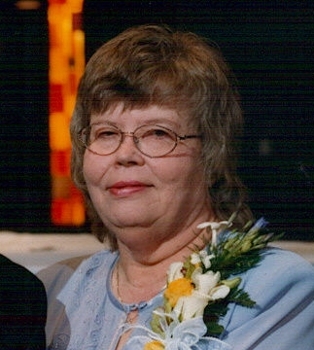
Jan Hoppe
Member of the MSB 1996 - 2017
Jan played clarinet and bass clarinet in the Band for 21 years. During that time, she served on the board as Treasurer for many years.

Slide 11
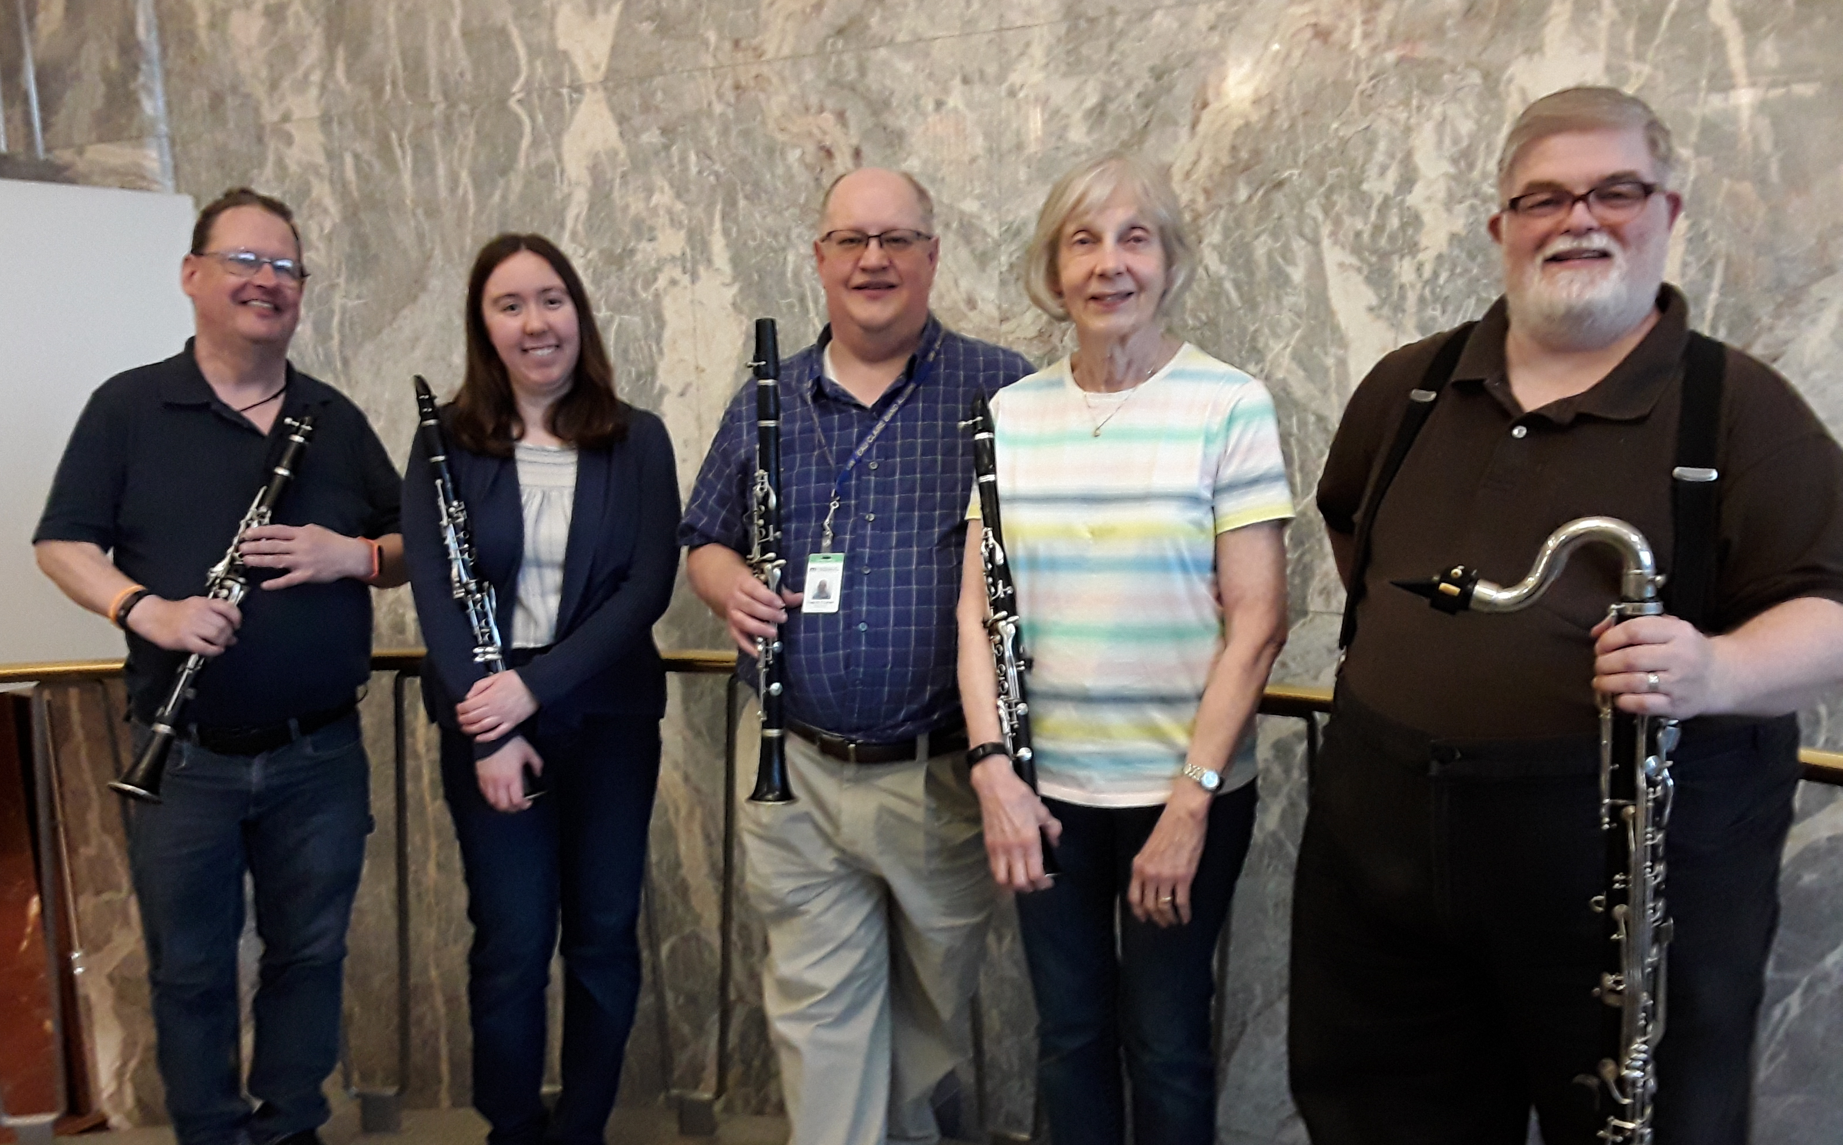
Our Clarinet Section
Greg, Kat, Fred, Donna and Evan
Not pictured: Anthony, Sara and Carmen

Slide 12
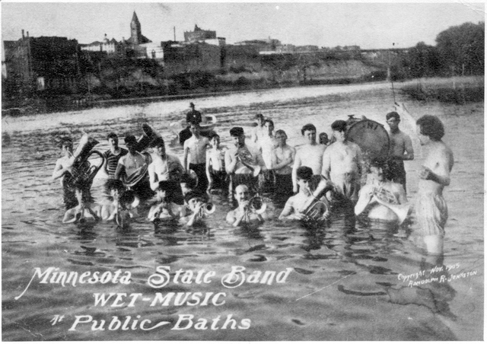
Harriet Island Public Baths - 1904
Notes:
Slide 21 – Band in the Water
… jump in the river. With your instrument, of course. Something tells me that this might have been a bit shocking. You can see the gentleman behind the band wearing a proper bathing costume. The band members appear to be wearing only their boxers.
Final Slide
12

Slide 13
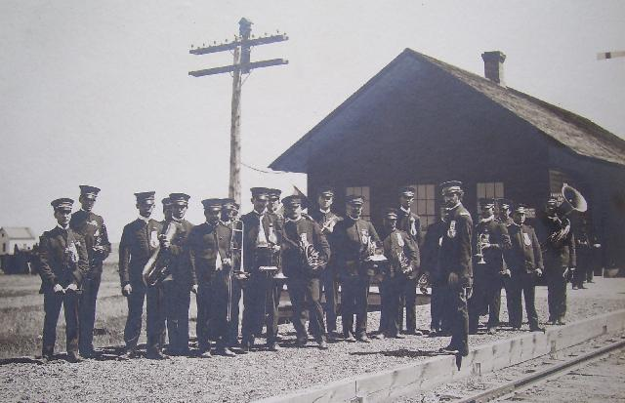
The Band at Murray, ND - 1906

Slide 14
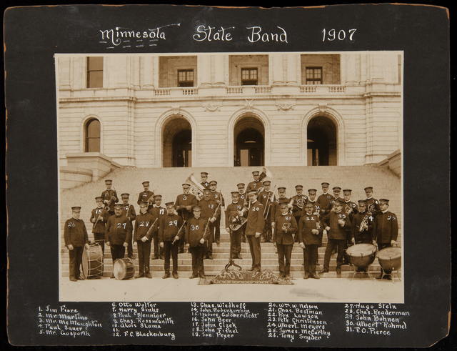
On the Steps of the State Capitol - 1907

Slide 15
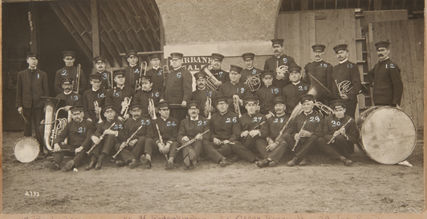
Minnesota State Fair Grandstand – 1911?
Notes:
Slide 16 – State Fair
It’s not quite certain when this picture and the next one were taken, but Tony Snyder is the Director, so they date sometime between 1911 and 1931. The Minnesota State Band was a fixture at the annual State Fair beginning in 1905, where they played concerts in front of the Grandstand every evening. In 1905 they band was paid $650 for their Fair appearances.
The band’s relationship with the State Fair was renewed in the 1970’s, where the now all-volunteer organization presented two concerts at the Fair each year. In 2004, a song by Teresia Cashin was presented by Minnesota Public Radio, entitled The Great Minnesota State Fair. The composer mentioned the band in her lyrics:
With the Fair that is known, yes, known far and near
As the best in our own native land;
There you'll hear the State Band render music that's grand
At the Great Minnesota State Fair
Songs of the State and the Fair are available on MPR’s website.
Next Slide.
15

Slide 16
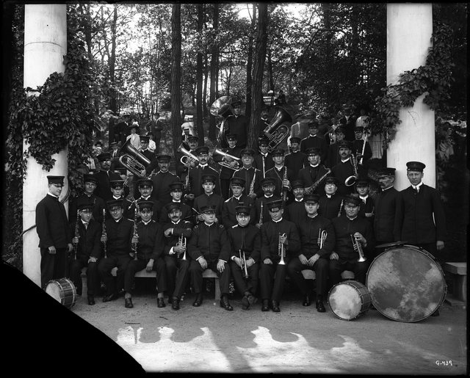
The Band at Como Park Pavilion - 1911
Notes:
Here we see a picture of the Minnesota State Band taken at Como Park in 1911. We would just like to remind you that the band still plays every Summer at the Como Park Pavilion. Please join us there on Memorial Day, May 28th, at 5:00 PM, for a concert of patriotic music and remembrance. We will also be performing in the Pavilion the first three Wednesdays in August at 7:00 PM. All three concerts will have completely different music, so you can come all three weeks and never hear a repeat.
Music.
Next Slide.
16

Slide 17
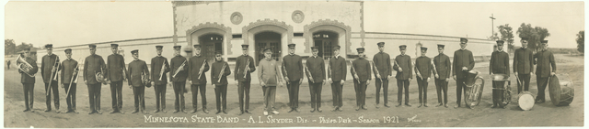
The Band at the Lake Phalen Pavilion - 1921
Notes:
Slide 14 - Band
The Saint Paul Park Commission acquired the lake and surrounding area for $22,000 and established Phalen Park in 1899. The first pavilion was constructed in 1903 and was replaced in 1923. This is a panorama shot of the Band taken in front of the original Lake Phalen pavilion in 1921. The band played there regularly until at least 1926, usually every evening for two weeks at a time.
17

Slide 18
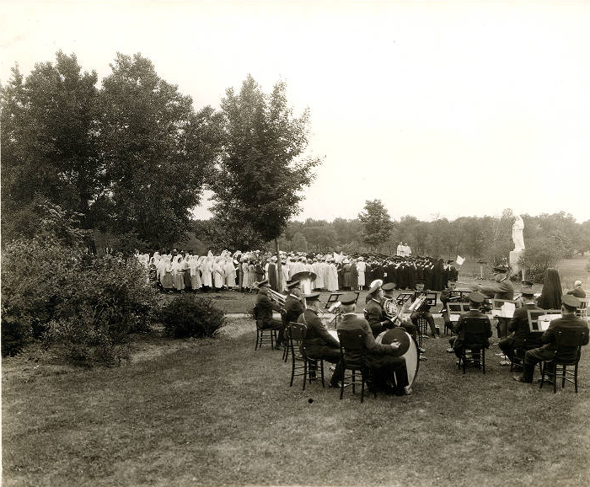
MSB at the College of St. Catherine - 1923
The occasion was the dedication of the Sacred Heart statue on the campus of St. Kate’s. The statue is still in its original location.

Slide 19
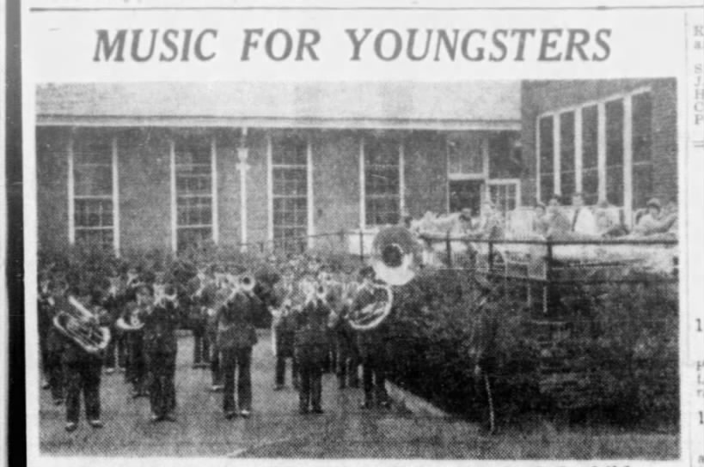
MSB at the Shrine Children’s Hospital June 1941

Slide 20
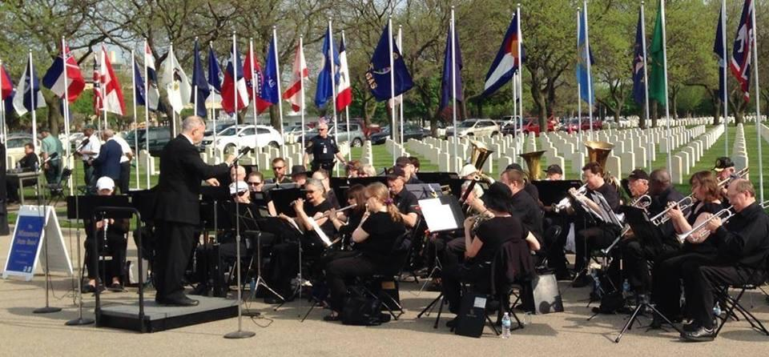
Memorial Day at Fort Snelling
National Cemetery, 2013

Slide 21
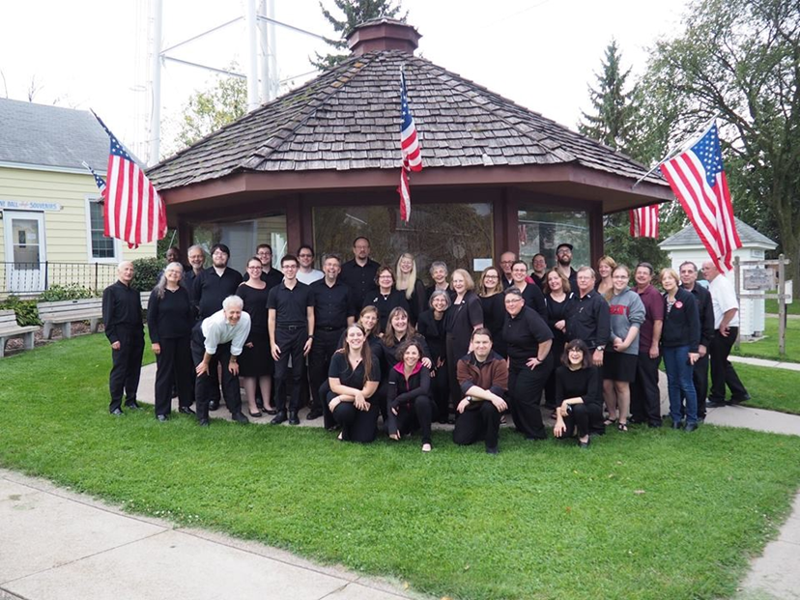
In Darwin, Minnesota - 2016

Slide 22
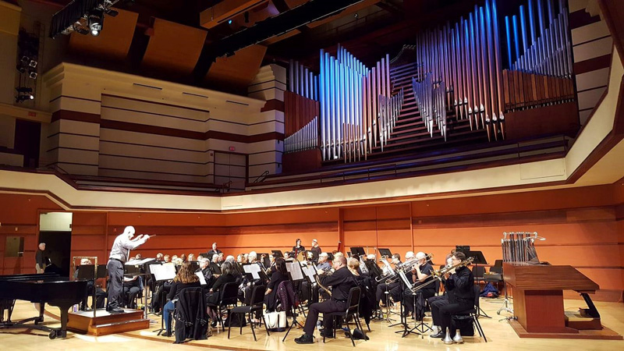
120th Anniversary Concert at
Benson Great Hall, 2018

Slide 23
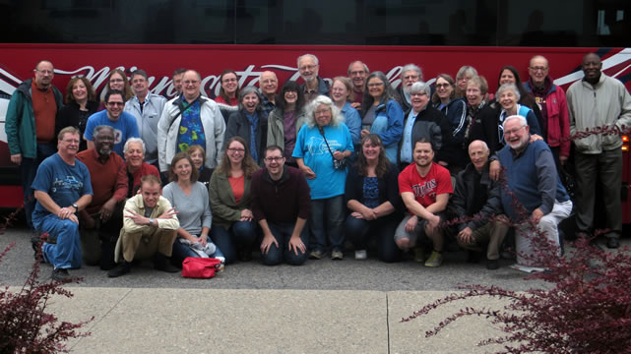
Thank You for Attending Today’s Concert!

